Slide 1
Christ School of Ministry
Old Testament Survey
Lesson Ten
Kings
Edwin Hathaway Instructor
First Apostolic Church
Dee Jay Shoulders Pastor
Jonathan Denton Family Pastor

Slide 2
Kings
Author:
There is no known author for Kings. The Jewish tradition preserved in the Babylonian Talmud attributes the books of Kings to Jeremiah the prophet.
The theological interests that present themselves in the books of the Kings are:
Purity of temple worship and the centrality of the temple cult in Jerusalem.
The fulfillment of previous prophetic revelation related to Hebrew kingship.
The reality of the blessings and curses formula as presented in the Mosaic Covenant.

Slide 3
Kings
Key Ideas
Kingship -- Good and Evil
The prophetic voice as the royal conscience
Worship -- Yahwism verses Baalism
Covenant Blessings (repentance and restoration)
And Curses (judgment and exile)

Slide 4
Kings
Purpose Statement
The books of Kings continue the story of kingship begun in Samuel, and their primary purpose is to record the “Covenant Failure” of the Hebrew united and divided monarchies. The biblical narrative implicitly balances the notion of God’s sovereignty and the reality of human freedom and declares that God was justified in exiling His people for the failure of the Kings of Israel and Judah to uphold the ideals of the Davidic Covenant.

Slide 5
Kings
Major Themes:
Assessment of King Solomon
Preclassical and Classical Prophecy
Dynastic Succession and Charismatic Leadership
The Golden Calf Cult

Slide 6
Kings
God’s Presence
The books of Kings report God’s presence manifest in the form of a cloud of glory filling Solomon’s temple at it’s dedication (I Kings 8:10-11). The reality of the divine presence associated with the Jerusalem sanctuary is accented in the foil of divine abandonment of the temple and the fall of the Hebrew monarchies and the exile of God’s people (cf. Ezekiel 10:18-19).

Slide 7
Kings
The policies and programs instituted by Solomon contributing to the eventual split of the kingdom included:
1. Political alliance to foreign nations by marriage. (I Kings 3:1-2)
2. Tendency to worship Yahweh and the Canaanite cults of Baal and other deities in an effort to appease both the Hebrew and Canaanite populations in Palestine. (I Kings 11:1-8)
3. The geographical realignment of Israel into twelve administrative districts in an attempt to erase old tribal boundaries and loyalties. (gerrymandering) (I Kings 4-7-19)
4. The proliferation of state bureaucracy. (I Kings 4:22-28)
5. Lavish building projects requiring slave labor from both Hebrew and non-Hebrew residents of Israel. (I Kings 9:15-22,5:13-18,12:9-11)
6. International trade and commerce resulted in the influx of pagan political and religious ideology in Jerusalem. (I Kings 9:26-28, 10:22-29)
7. The revolt of vassal nations as Solomon’s military power waned resulted in their tribute being shown as an increasing tax on the Hebrews. (I Kings 11:9-25)

Slide 8
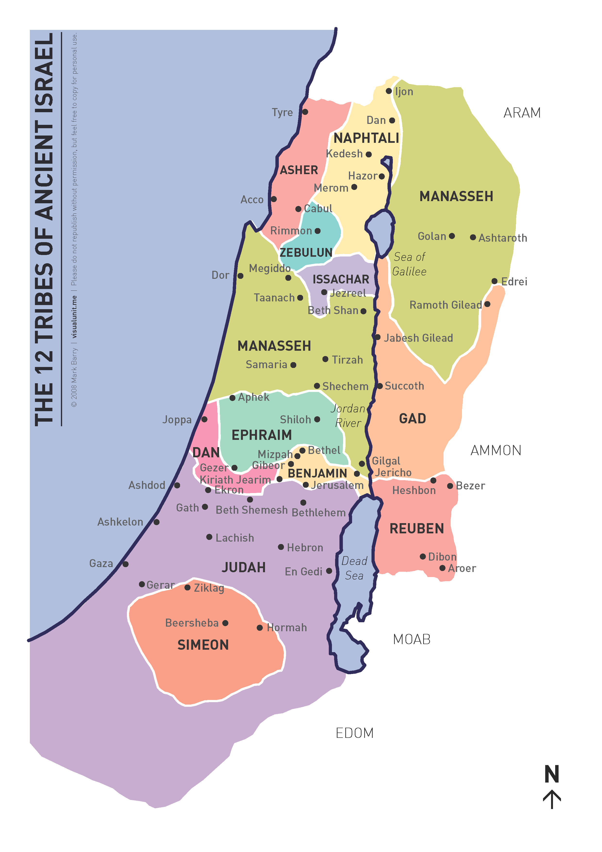

Slide 9
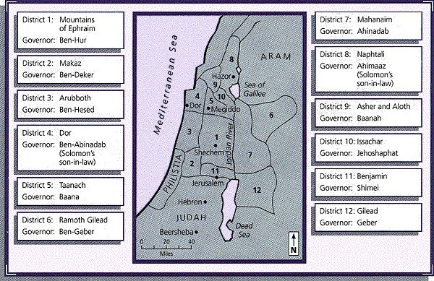

Slide 10
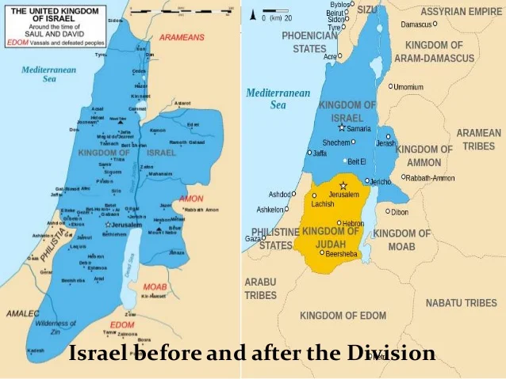

Slide 11
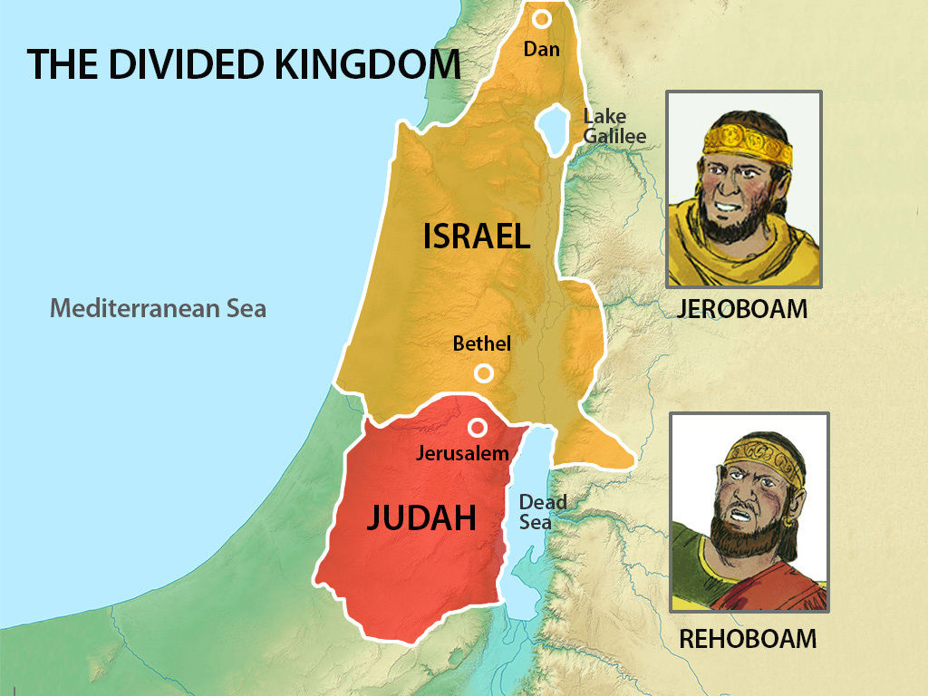

Slide 12
Kings
13 And behold, a man of God went from Judah to Bethel by the word of the Lord, and Jeroboam stood by the altar to burn incense. 2 Then he cried out against the altar by the word of the Lord, and said, "O altar, altar! Thus says the Lord: 'Behold, a child, Josiah by name, shall be born to the house of David; and on you he shall sacrifice the priests of the high places who burn incense on you, and men's bones shall be burned on you.'" 3 And he gave a sign the same day, saying, "This is the sign which the Lord has spoken: Surely the altar shall split apart, and the ashes on it shall be poured out."
4 So it came to pass when King Jeroboam heard the saying of the man of God, who cried out against the altar in Bethel, that he stretched out his hand from the altar, saying, "Arrest him!" Then his hand, which he stretched out toward him, withered, so that he could not pull it back to himself. 5 The altar also was split apart, and the ashes poured out from the altar, according to the sign which the man of God had given by the word of the Lord. 6 Then the king answered and said to the man of God, "Please entreat the favor of the Lord your God, and pray for me, that my hand may be restored to me."
So the man of God entreated the Lord, and the king's hand was restored to him, and became as before. 7 Then the king said to the man of God, "Come home with me and refresh yourself, and I will give you a reward."
8 But the man of God said to the king, "If you were to give me half your house, I would not go in with you; nor would I eat bread nor drink water in this place. 9 For so it was commanded me by the word of the Lord, saying, 'You shall not eat bread, nor drink water, nor return by the same way you came.'"

Slide 13
10 So he went another way and did not return by the way he came to Bethel.
Death of the Man of God 11 Now an old prophet dwelt in Bethel, and his sons came and told him all the works that the man of God had done that day in Bethel; they also told their father the words which he had spoken to the king. 12 And their father said to them, "Which way did he go?" For his sons had seen which way the man of God went who came from Judah. 13 Then he said to his sons, "Saddle the donkey for me." So they saddled the donkey for him; and he rode on it,
14 and went after the man of God, and found him sitting under an oak. Then he said to him, "Are you the man of God whught him back; 21 and he cried out to the me corpse. Then they went and told it in the city where the old prophet dwelt.
26 Now when the prophet who had brought him back from the way heard it, he said, "It is the man an of God who came from Judah, saying, "Thus says the Lord: 'Because you have disobeyed the word of the Lord, and have noto came from Judah?"
And he said, "I am."
15 Then he said to him, "Come home with me and eat bread."
16 And he said, "I cannot return with you nor go in with you; neither can I eat bread nor drink water with you in this place. 17 For I have been told by the word of the Lord, 'You shall not eat bread nor drink water there, nor return by going the way you came.'"
18 He said to him, "I too am a prophet as you are, and an angel spoke to me by the word of the Lord, saying, 'Bring him back with you to your house, that he may eat bread and drink water.'" (He was lying to him.)

Slide 14
19 So he went back with him, and ate bread in his house, and drank water.
2d the prophet took up the corpse of the man of God, laid it on the donkey, and brought it back. So the old prophet0 Now it happened, as they sat at the table, that the word of the Lord came to the prophet who had bro kept the commandment which the Lord your God commanded you, 22 but you came back, ate bread, and drank water in the place of which the Lord said to you, "Eat no bread and drink no water," your corpse shall not come to the tomb of your fathers.'"
23 So it was, after he had eaten bread and after he had drunk, that he saddled the donkey for him, the prophet whom he had brought back. 24 When he was gone, a lion met him on the road and killed him. And his corpse was thrown on the road, and the donkey stood by it. The lion also stood by the corpse. 25 And there, men passed by and saw the corpse thrown on the road, and the lion standing by thof God who was disobedient to the word of the Lord. Therefore the Lord has delivered him to the lion, which has torn him and killed him, according to the word of the Lord which He spoke to him." 27 And he spoke to his sons, saying, "Saddle the donkey for me." So they saddled it. 28 Then he went and found his corpse thrown on the road,
and the donkey and the lion standing by the corpse. The lion had not eaten the corpse nor torn the donkey. 29 An his bones. 32 For the saying which he cried out by the word of the Lord against the altar in Bethel, and against all the shrines on thecame to the city to mourn, and to bury him. 30 Then he laid the corpse in his own tomb; and they mourned over him, saying, "Alas, my brother!" 31 So it was, after he had buried him, that he spoke to his sons, saying, "When I am dead, then bury me in the tomb where the man of God is buried; lay my bones beside high places which are in the cities of Samaria, will surely come to pass."
NKJV

Slide 15
Kings
One of the first patterns to notice is the difference in dynasties between the two kingdoms. The northern kingdom, Israel, had a continuous cycle of regicide and usurpation; only two of its dynasties survived more than two generations. The average reign lasted ten years. In contrast, the southern kingdom, Judah, had a single unbroken dynasty (descending from David), an enviable source of stability that would be desired by any monarchy in history. The average reign of the kings of Judah was seventeen years. While the kings of Judah were not perfect, their relative righteousness compared to Israel is a reminder that obedience brings blessings. This enduring royal line of the southern kingdom also evokes promises regarding David and the house of Judah (e.g., Gen. 49:10; 2 Sam. 7:12–16; 1 Kgs. 9:5; Ps. 89:35–36; Jer. 33:17).

Slide 19
Kings
Another notable segment of the two royal lines is where they connect—when King Jehoram of Judah married Athaliah, daughter of King Ahab of Israel. Perhaps motivated by a noble desire to reunite the tragically divided kingdom, the intermarriage actually resulted in the north having a corrosive immoral influence on the south. Daughter of Jezebel, an idolatrous, prophet-killing gentile, Queen Athaliah turned out to be as rotten as her mother, killing her own children in order to gain the throne of Judah and spread idolatrous worship. She almost subverted God’s promises that David’s line would continue, but for a grandchild who survived. The incident, which resulted from a bad marriage decision, however well-intended, is a reminder that unity and peace should never come at the cost of compromising vital principles.

Slide 21
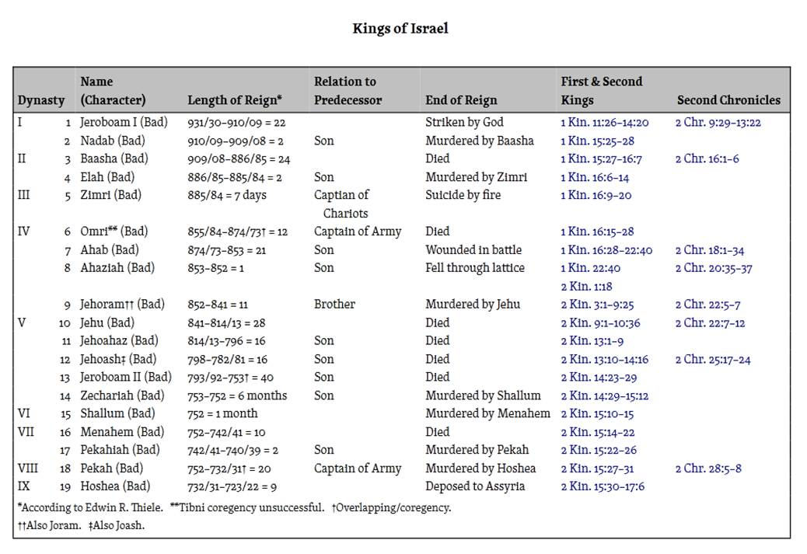

Slide 22
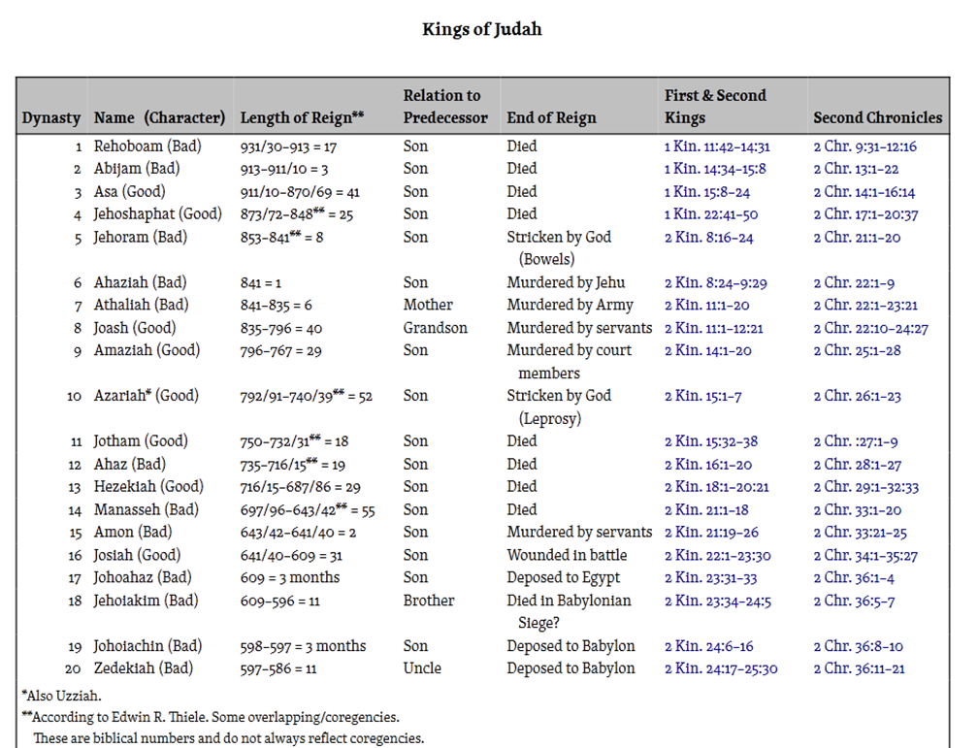

Slide 23
